Slide 1


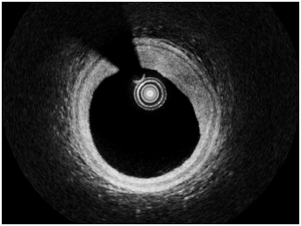

Optical coherence tomography (old)
Figure 4
Intracoronary OCT: eccentric fibrous plaqueOver the complete vessel circumference, the intimal lumen border can be visualised as well as the media identified as a signal-poor, dark structureand the lamina elastic externa as a thin, signal-rich structure. In such cases, OCT allows assessment of the complete plaque and determinationof the plaque burden.[OCT image source: Terumo prototype]
Francesco Prati, Flavio Giuseppe Biccirè
©2025 Europa Group - All rights reserved.

