Slide 1


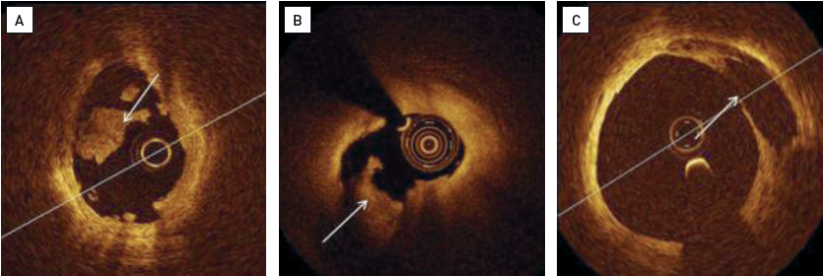

Optical coherence tomography (old)
Figure 8
Examples of plaque disruption(A) Intraluminal thrombus (arrow) due to plaque erosion, superimposed on a mild plaque without atheroma. (B) Rupture of a lipid necrotic pool (arrow) with mild intraluminal thrombus. (C) Old quiescent lipid necrotic plaque rupture. A plaque cavity is in contact with the lumen without intracoronary thrombus (arrow). [OCT image source: St. Jude/LightLab Imaging C7XR]
Francesco Prati, Flavio Giuseppe Biccirè
©2025 Europa Group - All rights reserved.

