Slide 1


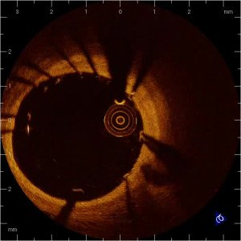

Optical coherence tomography (old)
MOVING IMAGE 1
“090793 OCT acute post stent”: OCT (St. Jude/LightLab Imaging) immediately after coronary stent implantation. Strut malapposition as well as tissue prolapse can be observed.
Francesco Prati, Flavio Giuseppe Biccirè
©2025 Europa Group - All rights reserved.

