Slide 1


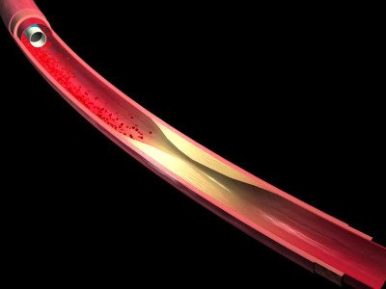

Optical coherence tomography (old)
MOVING IMAGE 2
“Animation of C7 deployment”: schematic (courtesy of St. Jude/LightLab Imaging) illustrating the practical application of Fourier domain OCT in the cathlab. A guidewire is introduced into the coronary, the OCT imaging catheter is advanced distally to the region of interest and then withdrawn during simultaneous flush delivery through the guide catheter.
Francesco Prati, Flavio Giuseppe Biccirè
©2025 Europa Group - All rights reserved.

