Slide 1


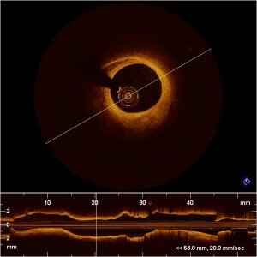
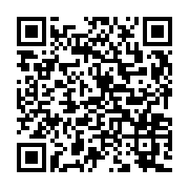
Optical coherence tomography (old)
MOVING IMAGE 3
“C7 pullback real time”: example of an intracoronary Fourier domain OCT pullback (St. Jude/LightLab Imaging). The pullback speed is 20 mm/sec. Therefore, the pullback does not cause ischaemia and shows few motion artefacts.
Francesco Prati, Flavio Giuseppe Biccirè
©2025 Europa Group - All rights reserved.

