Slide 1


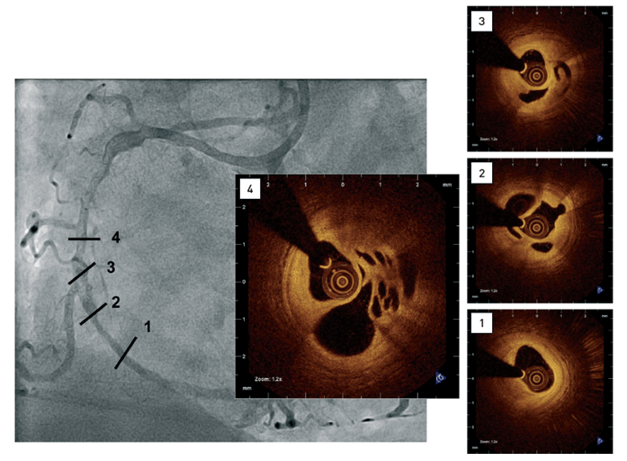

Optical coherence tomography
Figure 13
Coronary angiogram showing diffuse disease including a complex hazy lesion(1-4) Intracoronary OCT confirming small lumen size, the presence of predominantly signal-rich, fibrous tissue and multiple channels.[OCT image source: St. Jude/LightLab Imaging C7XR]
Francesco Prati, Flavio Giuseppe Biccirè, Ziad A Ali, Alessandro Sticchi, Evelyn S. Regar, Piera Capranzano
©2025 Europa Group - All rights reserved.

