Slide 1


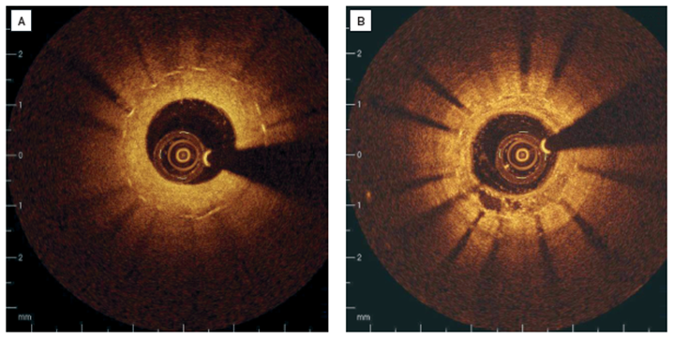

Optical coherence tomography
Figure 14
Clinical examples of intracoronary OCT in patients with restenosis(A) Stent struts are covered with relatively thick, homogenous, signal rich tissue. (B) Covering of the stent struts is seen to be inhomogeneous, suggesting neovascularisation in 7 o’clock position.[OCT image source: St. Jude/LightLab Imaging C7XR]
Francesco Prati, Flavio Giuseppe Biccirè, Ziad A Ali, Alessandro Sticchi, Evelyn S. Regar, Piera Capranzano
©2025 Europa Group - All rights reserved.

