Slide 1


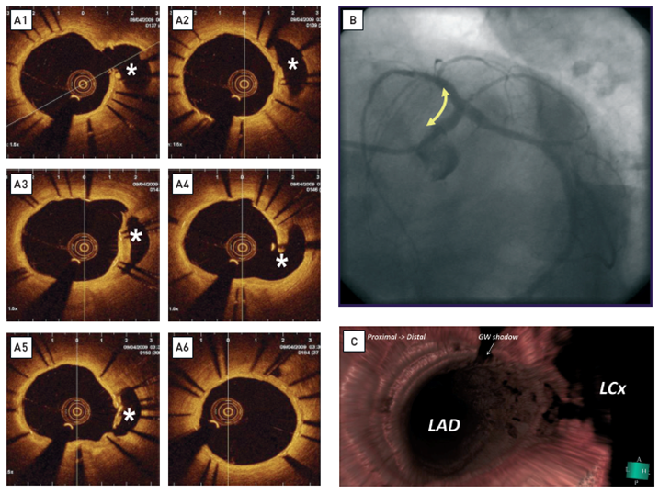

Optical coherence tomography
Figure 15
Long-term follow-up (1 year) after treatment of the left main bifurcation by stenting from the left anterior descending artery into the left main stem across the left circumflex artery(A) OCT reveals rather uniform, homogeneous, signal-rich tissue coverage of the stent and visualises the struts across the ostium of the left circumflex artery (asterix). All non-apposed side branch struts show tissue coverage. The ostium of the left circumflex is patent. [OCT image source: St. Jude/LightLab C7XR]. (B) Coronary angiogram at 1-year follow-up. (C) 3D rendering of the OCT data. En face view from proximal to distal demonstratesthe strut’s geometry at the carina.
Francesco Prati, Flavio Giuseppe Biccirè, Ziad A Ali, Alessandro Sticchi, Evelyn S. Regar, Piera Capranzano
©2025 Europa Group - All rights reserved.

