Slide 1


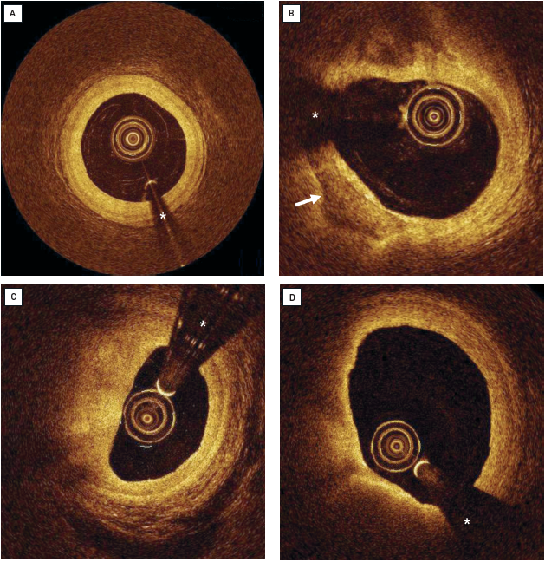

Optical coherence tomography
Figure 5
Example of plaque characterisation by visual assessment(A) Concentric intimal thickening. The intima is concentric, homogenous signal-rich (yellow). The signal-poor, dark media is circumferentially visiblyover the complete vessel circumference. (B) Calcification appearing as a signal-poor, relatively dark structure with sharply delineated borders (arrow). (C) Eccentric fibrofatty plaque in 6 to 12 o’clock position showing typical gradual diminishing of the OCT signal towards the adventitia. (D) Eccentric lipid-rich plaque in 5 to 11 o’clock position. Typically, a fibrous cap can be recognised as a signal-rich, yellow structure towards the lumen with a rapid drop in signal intensity towards the abluminal plaque side, caused by the high attenuation of lipid-rich tissue.* indicates guidewire artefact.[OCT image source: St. Jude/Lightlab Imaging C7XR]
Francesco Prati, Flavio Giuseppe Biccirè, Ziad A Ali, Alessandro Sticchi, Evelyn S. Regar, Piera Capranzano
©2025 Europa Group - All rights reserved.

