Slide 1


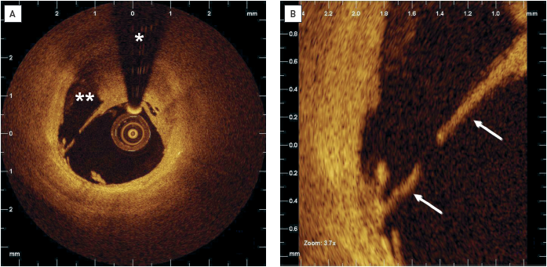

Optical coherence tomography
Figure 7
Clinical example of a ruptured plaque in a patient undergoing primary PCI(A) OCT imaging has been performed after intracoronary thrombus aspiration. The thin fibrous cap has ruptured in the shoulder region of the eccentric plaque. Remnants of the necrotic core are in direct contact with the blood stream(**). (B) Magnification showing the rupture site of the thin fibrous cap (arrows). * indicates guidewire artefact. OCT image source: St. Jude/LightLab Imaging C7XR]
Francesco Prati, Flavio Giuseppe Biccirè, Ziad A Ali, Alessandro Sticchi, Evelyn S. Regar, Piera Capranzano
©2025 Europa Group - All rights reserved.

