Slide 1


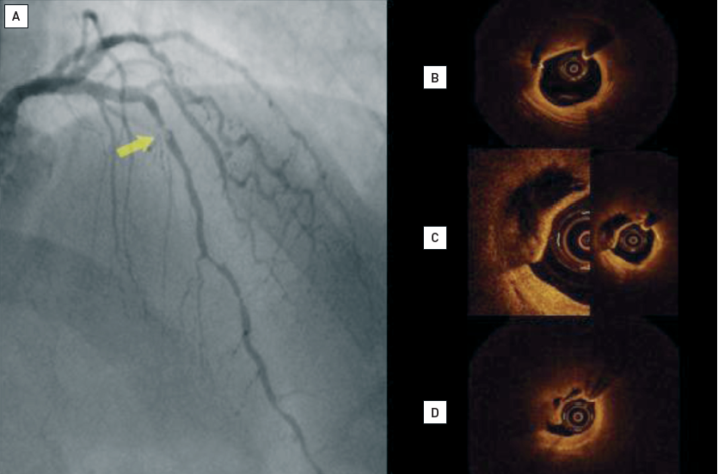

Optical coherence tomography
Figure 9
Example of plaque rupture(A) The angiogram shows a tight lesion with haziness in the mid left anterior descending (arrow). Corresponding OCT images show: (B) a large lipid pool immediately above the lesion; (C) rupture of the fibrous cap; (D) tight lumen narrowing due to fibrous cap rupture and overlying thrombus (panel C).
[OCT image source: St. Jude/LightLab Imaging C7XR]
Francesco Prati, Flavio Giuseppe Biccirè, Ziad A Ali, Alessandro Sticchi, Evelyn S. Regar, Piera Capranzano
©2025 Europa Group - All rights reserved.

