Slide 1


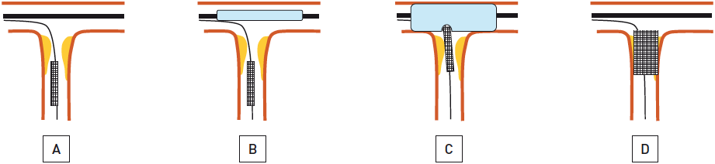
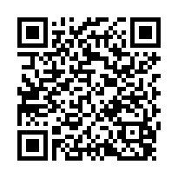
Ostial lesions
Figure 4
Draw-back stent deployment techniquePlacement of a second wire in the non-target vessel and advancing the stent beyond the lesion in the target vessel (A). A slightly undersized compliant balloon is advanced over-the-wire in the non-target vessel opposite to the ostium (B). After low pressure inflation of the balloon with 6-8 atm the stent is pulled back until an indentation is observed on the balloon (C). The stent is inflated and both balloons are deflated and removed (D).
Christoph K. Naber, Thomas Schmitz, Eberhard Grube, Georg Sabin
©2025 Europa Group - All rights reserved.

