Slide 1


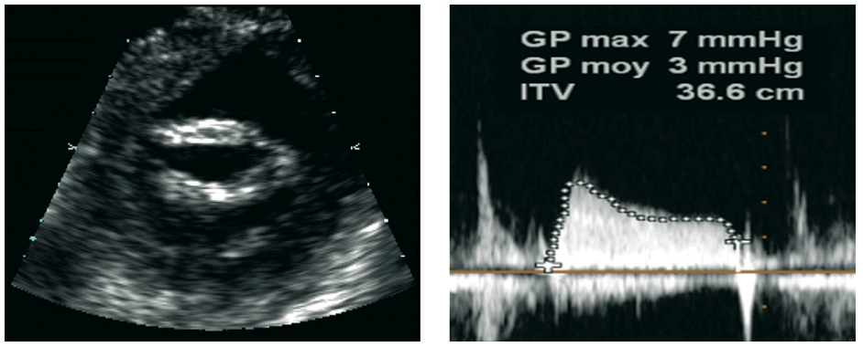

Percutaneous balloon mitral commissurotomy
Figure 11
Final results after percutaneous mitral commissurotomy2D echocardiography showing bicommissural opening and low mean mitral gradient
Alec Vahanian, Dominique Himbert, Eric Brochet, Gregory Ducrocq, Marina Urena, Bernard Lung
©2025 Europa Group - All rights reserved.

