Slide 1


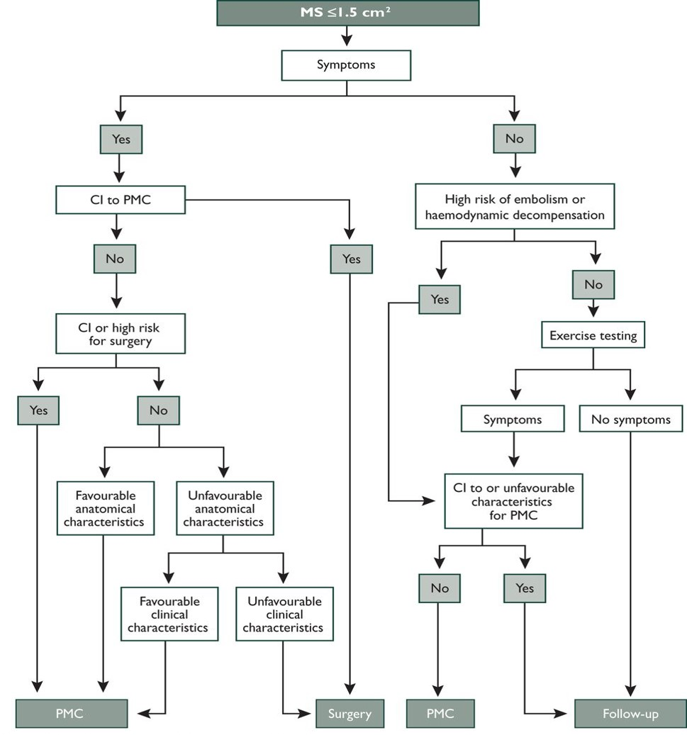

Percutaneous balloon mitral commissurotomy
Figure 16
Management of patients with mitral stenosis with balloon mitral commissurotomy (ESC/EACTS Guidelines 2012) [80].
Alec Vahanian, Dominique Himbert, Eric Brochet, Gregory Ducrocq, Marina Urena, Bernard Lung
©2025 Europa Group - All rights reserved.

