Slide 1


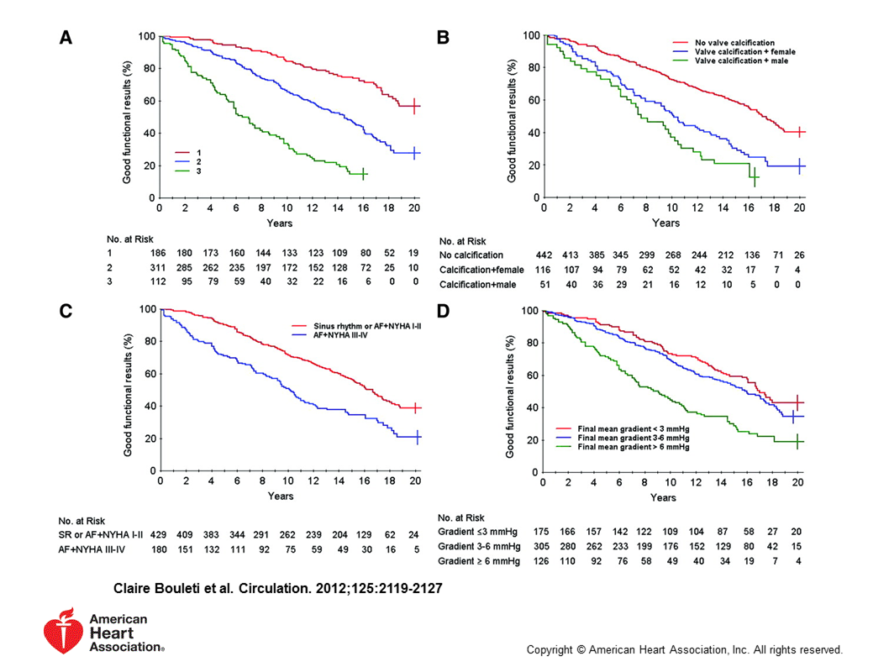

Percutaneous balloon mitral commissurotomy
Figure 17A
Prediction of Long-Term Results of Percutaneous mitral commissurotomy. An actuarial curve showing the outcomes according to the Score described in Table 6.
Alec Vahanian, Dominique Himbert, Eric Brochet, Gregory Ducrocq, Marina Urena, Bernard Lung
©2025 Europa Group - All rights reserved.

