Slide 1


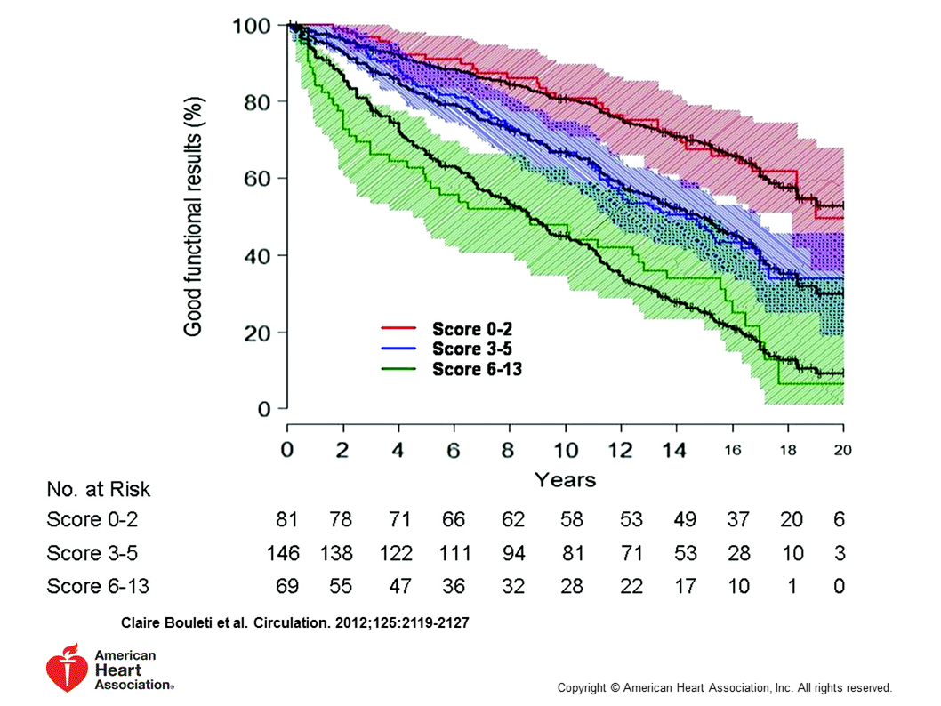

Percutaneous balloon mitral commissurotomy
Figure 17B
Assessment of the performance of the score in the validation cohortPredicted and observed outcomes of a patient with moderately calcified valve but favourable anatomical characteristics (Score 3-5). [39]
Alec Vahanian, Dominique Himbert, Eric Brochet, Gregory Ducrocq, Marina Urena, Bernard Lung
©2025 Europa Group - All rights reserved.

