Slide 1


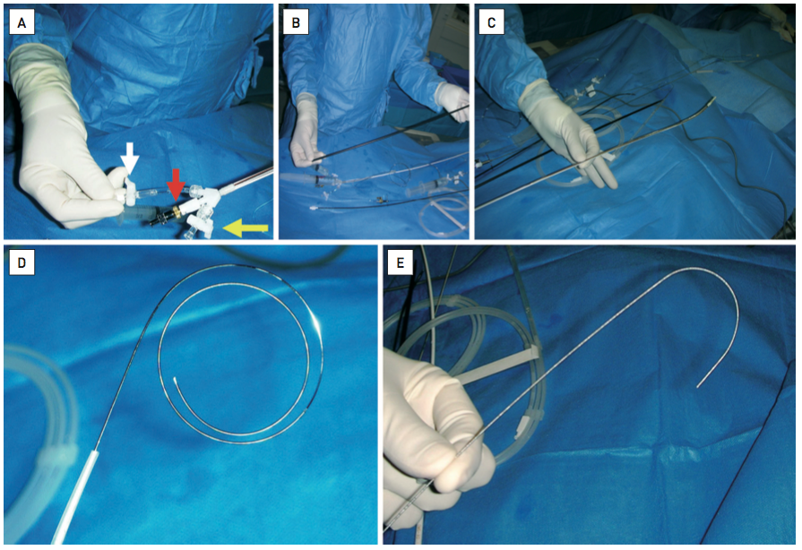

Percutaneous balloon mitral commissurotomy
Figure 2
The Inoue balloon(A) The proximal part of the balloon has a vent tube which should be purged carefully before use (white and yellow arrows). The stretching tube (grey) is inserted within the inner tube inner tube is inserted (red and black arrows). (B) the 14 Fr dilator. (C) the shaft of the Inoue balloon is shown. (D) the guidewire has a distal part which is very flexible and a proximal part which is stiff. (E) the stylet allows for manipulating the Inoue balloon in the left atrium and across the mitral valve.
Alec Vahanian, Dominique Himbert, Eric Brochet, Gregory Ducrocq, Marina Urena, Bernard Lung
©2025 Europa Group - All rights reserved.

