Slide 1


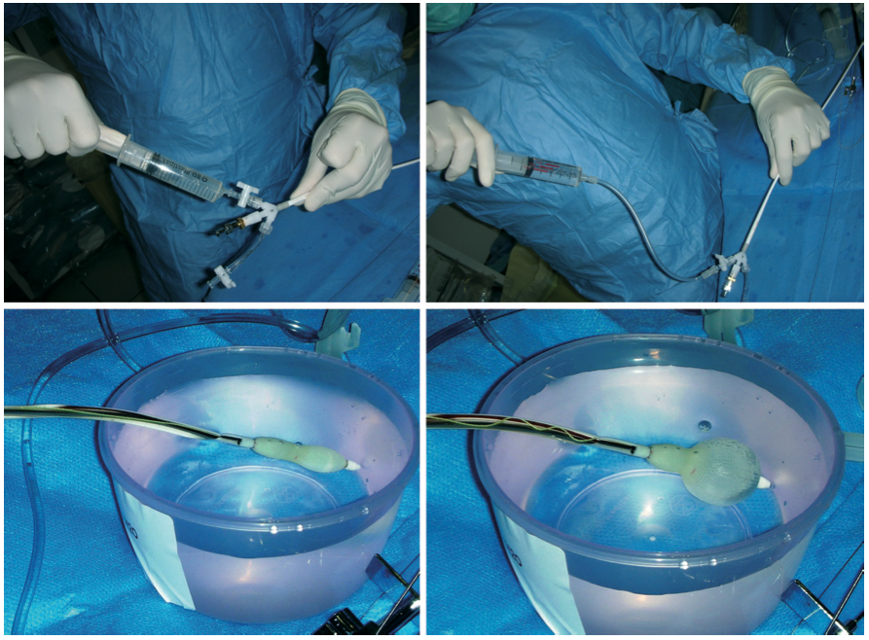

Percutaneous balloon mitral commissurotomy
Figure 4
Preparation of the Inoue balloonThe Inoue balloon should be carefully purged using the vent tube before utilisation. A syringe filled with diluted contrast is inflated and deflated in a basin of water in order to “de-bubble” the balloon.
Alec Vahanian, Dominique Himbert, Eric Brochet, Gregory Ducrocq, Marina Urena, Bernard Lung
©2025 Europa Group - All rights reserved.

