Slide 1


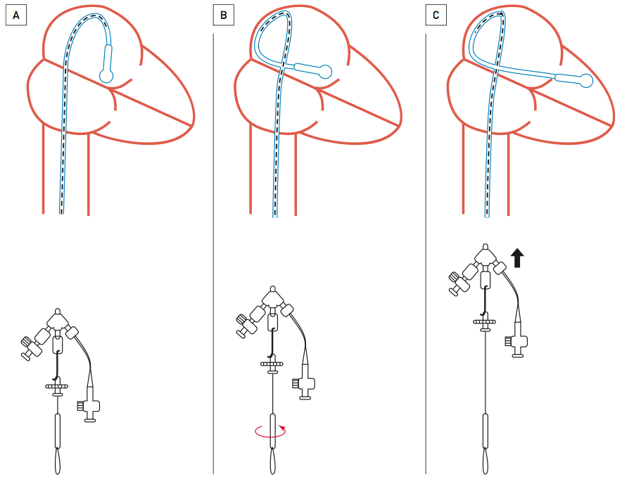

Percutaneous balloon mitral commissurotomy
Figure 5
The “loop technique”The Inoue balloon should be advanced over the guidewire in the shape of the left atrial arch, maintaining a large loop in the left atrium. The guidewire is withdrawn and the stylet is introduced (A). Then the stylet tip is withdrawn to a point 5 cm from the tip of the balloon. The stylet is rotated clockwise and held stationary to orient the balloon tip towards the posteroinferior atrial wall (B). The balloon only is advanced which will make the catheter form a loop in the left atrium. The balloon is advanced further while the stylet is slightly removed, as this will make the catheter cross the mitral valve (C). After the balloon has crossed the mitral valve, the balloon should be inflated while the catheter is pulled back in order to break the loop slowly.
Alec Vahanian, Dominique Himbert, Eric Brochet, Gregory Ducrocq, Marina Urena, Bernard Lung
©2025 Europa Group - All rights reserved.

