Slide 1


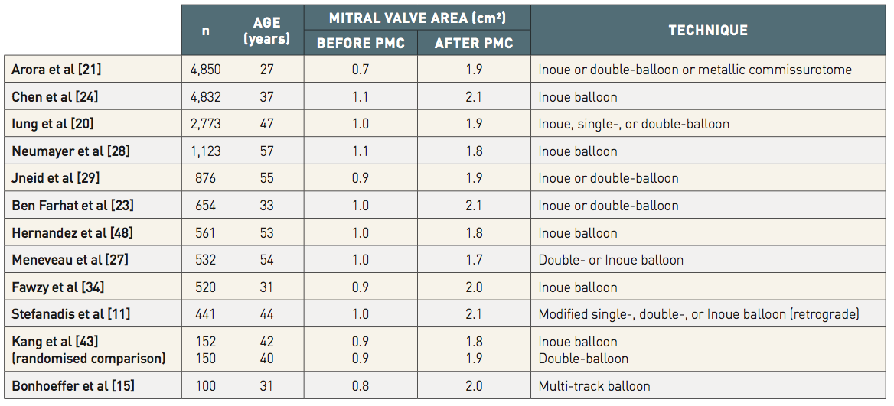

Percutaneous balloon mitral commissurotomy
Table 1
Immediate results of mitral commissurotomyImmediate results of percutaneous mitral commissurotomy (PMC) showing an increase in mitral valve area
Alec Vahanian, Dominique Himbert, Eric Brochet, Gregory Ducrocq, Marina Urena, Bernard Lung
©2025 Europa Group - All rights reserved.

