Slide 1


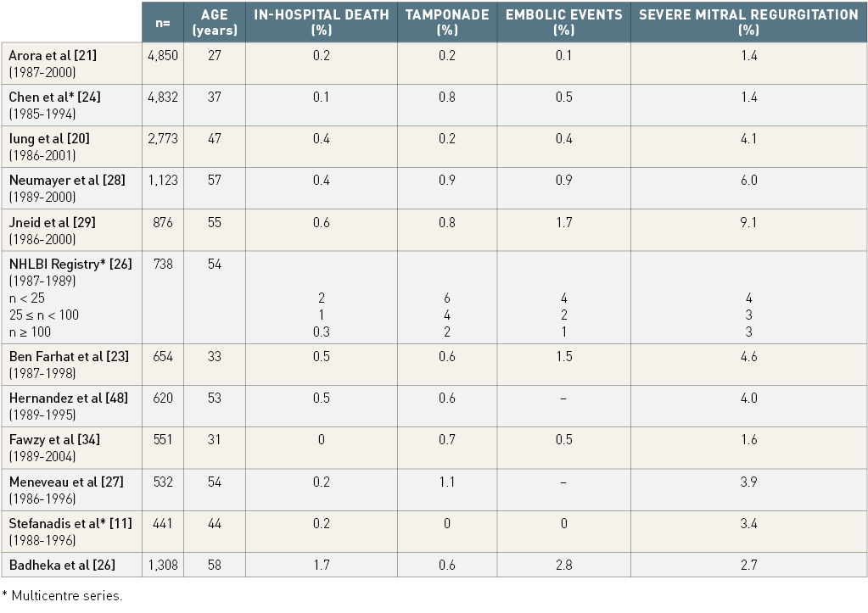

Percutaneous balloon mitral commissurotomy
Table 2
Severe complications of percutaneous mitral commissurotomy
Alec Vahanian, Dominique Himbert, Eric Brochet, Gregory Ducrocq, Marina Urena, Bernard Lung
©2025 Europa Group - All rights reserved.

