Slide 1


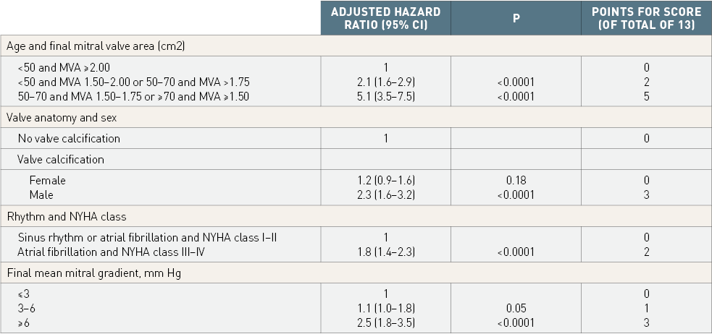

Percutaneous balloon mitral commissurotomy
Table 6
Predictive factors of poor late functional resultsPredictive factors of poor late functional results after good immediate results of percutaneous mitral commissurotomy (valve area > 1.5cm² with no regurgitation >2/4. Multivariate analysis and definition of a predictive score of long-term results The concordance between the score and the predicted long-term outcome is shown in figure 17. [39]
Alec Vahanian, Dominique Himbert, Eric Brochet, Gregory Ducrocq, Marina Urena, Bernard Lung
©2025 Europa Group - All rights reserved.

