Slide 1


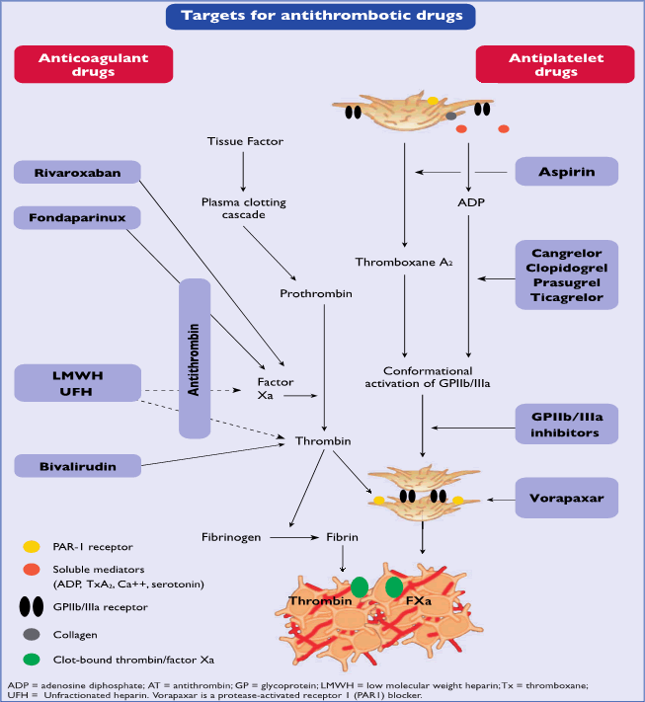
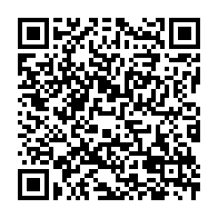
Peri-procedural and post-procedural antithrombotic pharmacotherapy (old)
Figure 1
Targets for antithrombotic drugs
Kurt Huber
©2025 Europa Group - All rights reserved.

