Slide 1

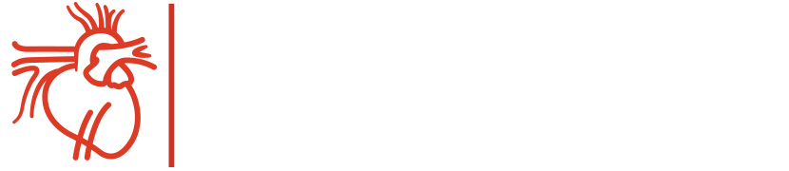
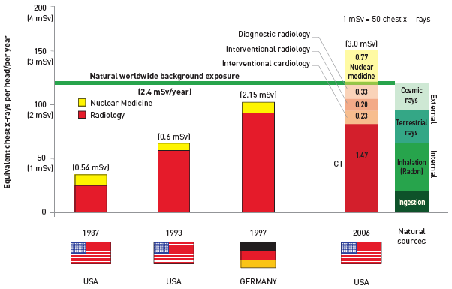
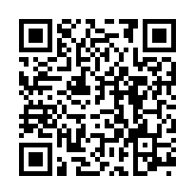
Radiation protection
Figure 1
Medical and natural sources of radiation
The effective dose of 1 mSv is equivalent to 50 chest x-rays.[Modified from [2] and updated from [3]]
Eugenio Picano, Maria Andreassi, Madan Rehani, Leonardo Bolognese, Eliseo Vano
©2025 Europa Group - All rights reserved.

