Slide 1


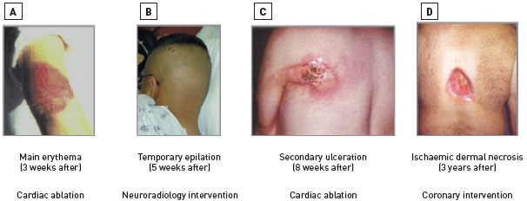

Radiation protection
Figure 10
Deterministic effects of ionising radiationRadiation effects can range from a few weeks [A] to a few years [B]. The site of injury corresponds to the site of entrance of the beam and reflects the beam orientation predominantly used in the procedure: the arm (when inappropriately positioned, with the patient’s elbow rested on the x-ray port during a cardiac ablation procedure) [A]. The head (during neuroradiology interventions, such as embolisation of a dermal artero-venous fistula[B], in a patient whose head was shaved before treatment with gamma knife surgery). The back in patients with cardiac ablation procedure or coronary intervention [C and D].[Reproduced and adapted from [40]]
Eugenio Picano, Maria Andreassi, Madan Rehani, Leonardo Bolognese, Eliseo Vano
©2025 Europa Group - All rights reserved.

