Slide 1


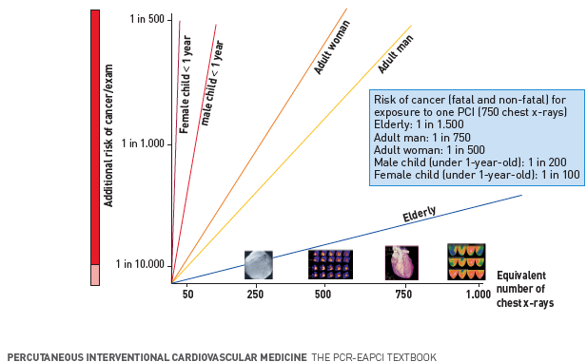
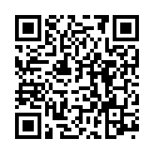
Radiation protection
Figure 11
Biological risk of imaging modalitiesSimplified effective dose ranges of some common medical procedures involving exposure to ionising radiation in diagnostic nuclear medicine and radiological procedures. The reference unit is one chest x-ray (postero-anterior projection), equal to an effective dose of 0.02 mSv. There is a linear relation between dose (x-axis) and risk (y-axis), with no safe dose (the risk line starts from zero) .[Modified from reference [20] and endorsed by IAEA, Sept. 2009].
Eugenio Picano, Maria Andreassi, Madan Rehani, Leonardo Bolognese, Eliseo Vano
©2025 Europa Group - All rights reserved.

