Slide 1


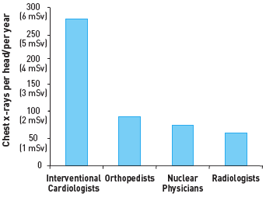

Radiation protection
Figure 12
Annual radiation exposure for different specialistsInterventional cardiologists are by far the most exposed.[Redrawn and modified from [43]]
Eugenio Picano, Maria Andreassi, Madan Rehani, Leonardo Bolognese, Eliseo Vano
©2025 Europa Group - All rights reserved.

