Slide 1


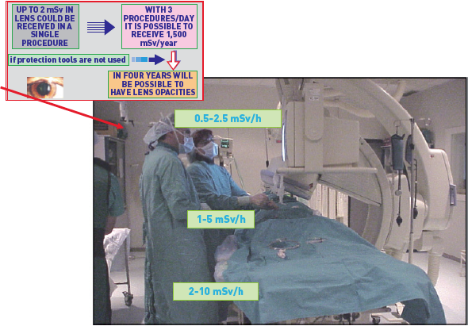

Radiation protection
Figure 13
The map of radiation exposure in the cardiac interventionalistThere are “hot regions” of higher exposure in the eye, thyroid, head, hands and legs. Reproduced from IAEA.
Eugenio Picano, Maria Andreassi, Madan Rehani, Leonardo Bolognese, Eliseo Vano
©2025 Europa Group - All rights reserved.

