Slide 1


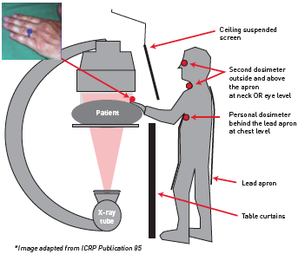

Radiation protection
Figure 14
The logistics of radiation, dosimetry and shielding in the cardiac catheterisation laboratory[Reproduced and adapted from IAEA poster (https://rpop.iaea.org/RPOP/RPoP/Content/Documents/Whitepapers/poster-staff-radiationprotection.pdf)]
Eugenio Picano, Maria Andreassi, Madan Rehani, Leonardo Bolognese, Eliseo Vano
©2025 Europa Group - All rights reserved.

