Slide 1


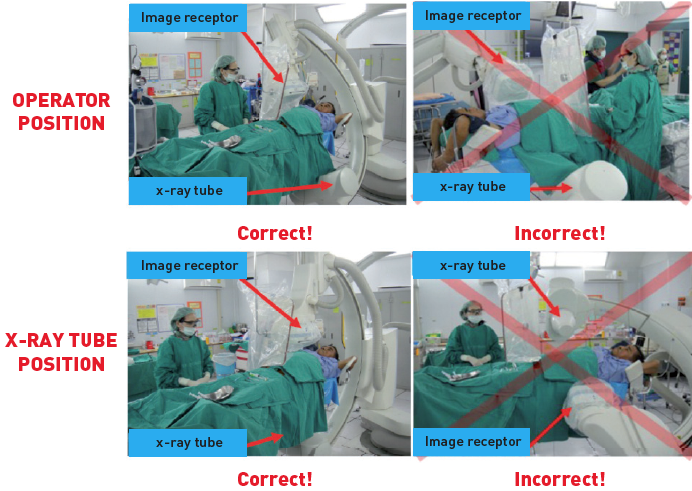
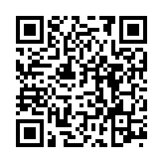
Radiation protection
Figure 16
Optimising practiceGood (left side) and bad (right side) radiation protection habits: the staff should stand on the side of image receptor, not of the x ray tube (upper panel); the x-ray tube should be kept under the patient table, not over it (lower panel).[Reproduced and adapted from IAEA poster (https://rpop.iaea.org/RPOP/RPoP/Content/Documents/Whitepapers/poster-staff-radiation-protection.pdf)]
Eugenio Picano, Maria Andreassi, Madan Rehani, Leonardo Bolognese, Eliseo Vano
©2025 Europa Group - All rights reserved.

