Slide 1


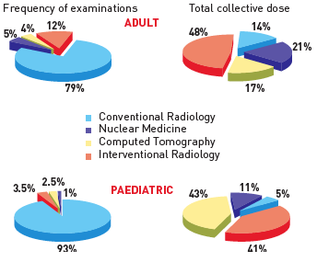

Radiation protection
Figure 2
Cumulative doses in cardiology patientsPie chart showing the total number of studies and cumulative dose in adult (upper panel) and paediatric (lower panel) cardiology patients. [Modified from reference [11] and [13]].
Eugenio Picano, Maria Andreassi, Madan Rehani, Leonardo Bolognese, Eliseo Vano
©2025 Europa Group - All rights reserved.

