Slide 1


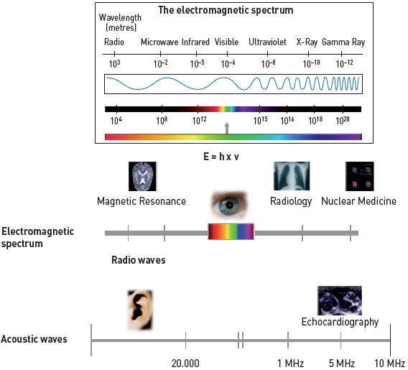

Radiation protection
Figure 3
Electromagnetic and acoustic spectraOnly high-energy electromagnetic waves (used in radiology and nuclear medicine) are capable of ionisation.
Eugenio Picano, Maria Andreassi, Madan Rehani, Leonardo Bolognese, Eliseo Vano
©2025 Europa Group - All rights reserved.

