Slide 1


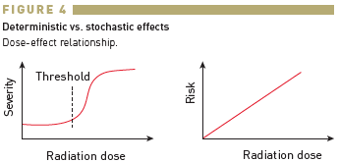

Radiation protection
Figure 4
Deterministic vs. stochastic effectsDose-effect relationship.
Eugenio Picano, Maria Andreassi, Madan Rehani, Leonardo Bolognese, Eliseo Vano
©2025 Europa Group - All rights reserved.

