Slide 1


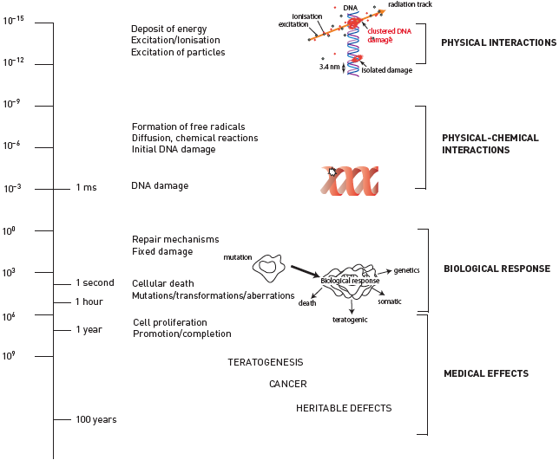

Radiation protection
Figure 5
Radiation-induced biological effcctsRadiation biological effects from physical interaction (a few milliseconds, upper part) to clinical effects (decades later).[Redrawn and modified from [1]]
Eugenio Picano, Maria Andreassi, Madan Rehani, Leonardo Bolognese, Eliseo Vano
©2025 Europa Group - All rights reserved.

