Slide 1


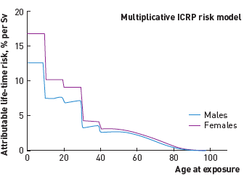

Radiation protection
Figure 6
Radiation-induced effects by genderRisk stratified according to age and gender. The risk is about 38% higher in women than in men, and four-fold higher in children aged
Eugenio Picano, Maria Andreassi, Madan Rehani, Leonardo Bolognese, Eliseo Vano
©2025 Europa Group - All rights reserved.

