Slide 1


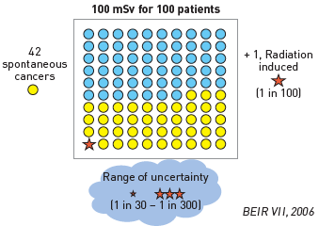
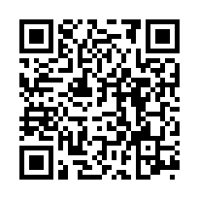
Radiation protection
Figure 7
The risk model for radiation-induced biological effectsThe risk model for Biological Effects of Ionising Radiation Committee VII for exposure to low-level radiation predict that about one (red star) out of 100 people would likely develop solid cancer or leukaemia from an exposure of 100 mSv above background. About 42 additional people (yellow circles) in the same group would be expected to develop solid cancer or leukaemia from other causes. Roughly half of these cancerswould result in death. This dose of 100 mSv is reached by 5% of patients in a single cardiac ablation or coronary angiography procedure. [Modified and adapted from [4]]
Eugenio Picano, Maria Andreassi, Madan Rehani, Leonardo Bolognese, Eliseo Vano
©2025 Europa Group - All rights reserved.

