Slide 1


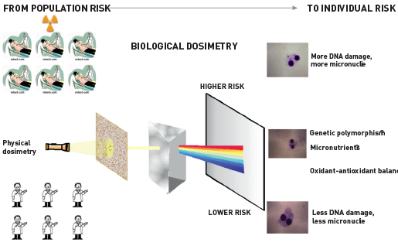

Radiation protection
Figure 8
Population versus individual riskThe population risk shown in Figure 7 is in reality due to the average of spectrum of risks, with higher risks being for instance associated with mutation of genes involved in DNA repair and with the presence of other environmental mutagens such as smoking.
Eugenio Picano, Maria Andreassi, Madan Rehani, Leonardo Bolognese, Eliseo Vano
©2025 Europa Group - All rights reserved.

