Slide 1


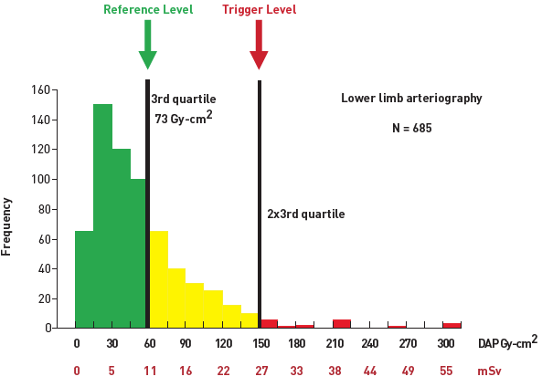

Radiation protection
Figure 9
Patient dose values distribution for lower limb arteriographyReference level (third quartile) and trigger level (twice the reference level) for potential individual dose analysis are shown as vertical lines. On the x-axis, the dose is expressed as DAP (amount of radiation) and with the corresponding whole-body effective dose in terms of equivalent chest x-rays and mSv (obtained from DAP with a conversion factor: mSv= 0.183 x DAP).[Redrawn and modified from [38]]
Eugenio Picano, Maria Andreassi, Madan Rehani, Leonardo Bolognese, Eliseo Vano
©2025 Europa Group - All rights reserved.

