Slide 1


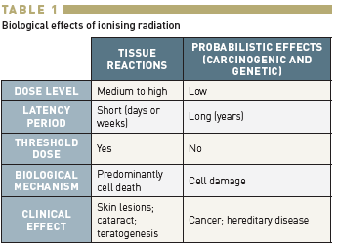

Radiation protection
Table 1
Biological effects of ionising radiation
Eugenio Picano, Maria Andreassi, Madan Rehani, Leonardo Bolognese, Eliseo Vano
©2025 Europa Group - All rights reserved.

