Slide 1


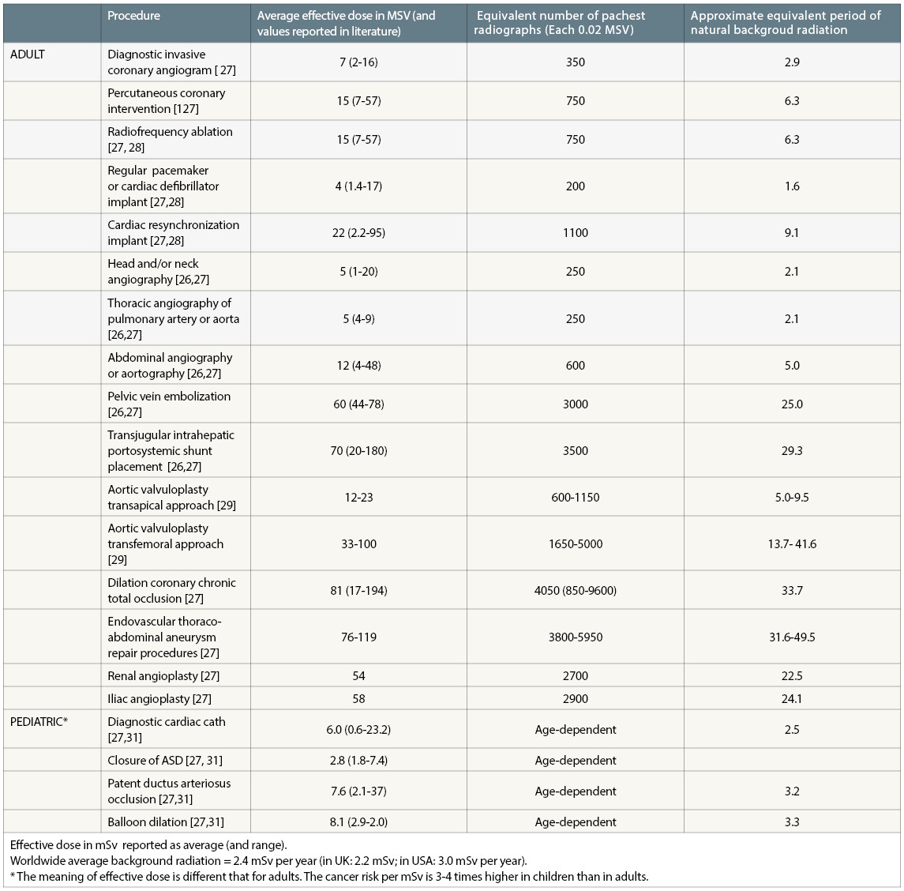
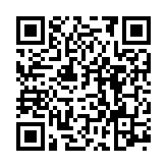
Radiation protection
Table 2
Typical effective doses from invasive cardiovascular medical exposures Effective dose in mSv reported as average (and range).Worldwide average background radiation = 2.4 mSv per year (in the UK: 2.2 mSv; in the USA: 3.0 mSv per year).* The meaning of effective dose is different from that for adults. The cancer risk per mSv is 3 to 4 times higher in children than in adults.
Eugenio Picano, Maria Andreassi, Madan Rehani, Leonardo Bolognese, Eliseo Vano
©2025 Europa Group - All rights reserved.

