Slide 1


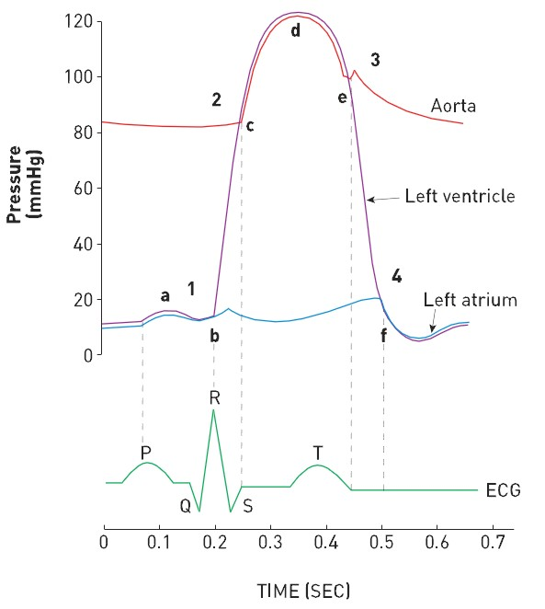

Right and left heart catheterisation (old)
Figure 1
The Wigger’s diagram of cardiac haemodynamics1=crossing point is mitral valve closure, 2=aortic valve opening, 3=aortic valve closure, 4= mitral valve opening. a=a wave, b=onset isovolumetric contraction, c =systolic ejection, d=peak ejection and beginning of diastolic relaxation, e= beginning of isovolumetric relaxation, f=initiation of LV filling.
Morton J. Kern
©2025 Europa Group - All rights reserved.

