Slide 1


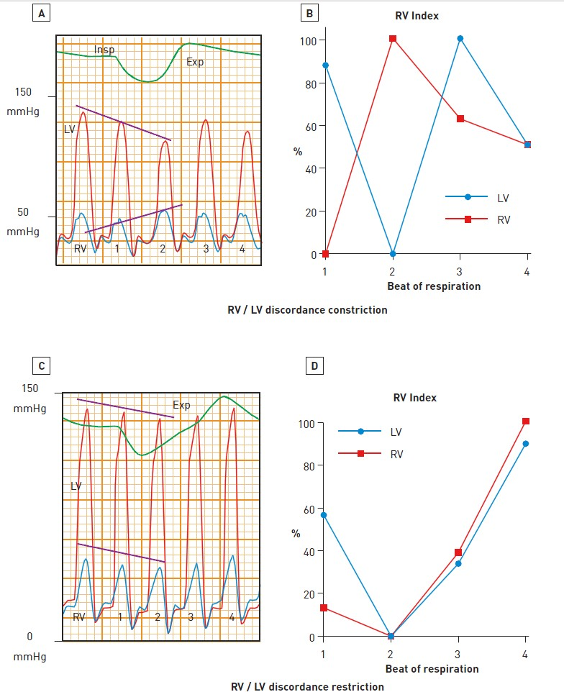

Right and left heart catheterisation (old)
Figure 10
Haemodynamics of constrictive pericarditis and heart failureHaemodynamic tracings illustrating respiratory changes in left (LV) and right (RV) ventricular systolic pressures in patients with constrictive pericarditis (group 1) (A) and other causes of heart failure (group 2) (C). The RV indexes for these specific examples are also shown (B & D), which demonstrate dis cordance in patient with constrictive pericarditis and concordance in the patient with heart failure. Value of dynamic respiratory changes in left and right ventricular pressures for the diagnosis of constrictive pericarditis.[From Hurrell et al [10]]
Morton J. Kern
©2025 Europa Group - All rights reserved.

