Slide 1


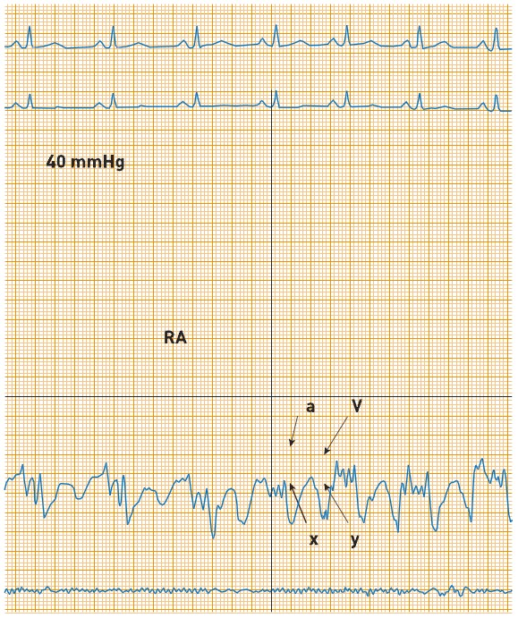

Right and left heart catheterisation (old)
Figure 2
Normal right atrial pressureWith atrial systole (“a” wave) and its diastole should be x descent, \"v\" wave is atrial filling wave.
Morton J. Kern
©2025 Europa Group - All rights reserved.

