Slide 1


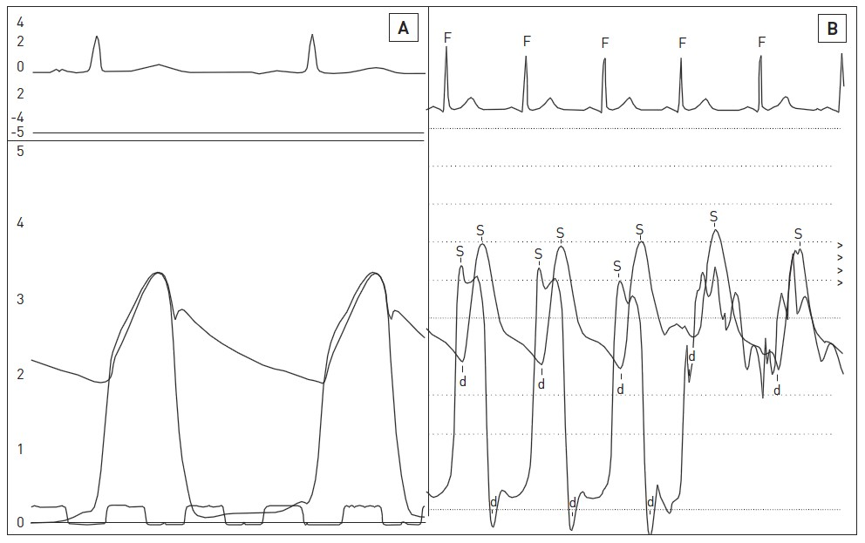

Right and left heart catheterisation (old)
Figure 4
Normal LV and aortic haemodynamics(A), high fidelity LV and simultaneous aortic pressures measured with dual micromanometer catheter.(B) fluid filled LV and femoral artery pressure waveforms showing under damped signals. The typical delay in pressure transmission to the femoral artery and its systolic pressure amplification above the LV systolic pressure is evident.
Morton J. Kern
©2025 Europa Group - All rights reserved.

