Slide 1


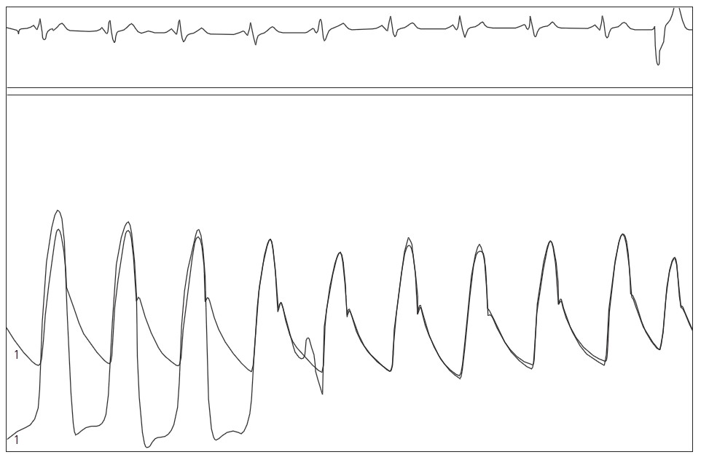

Right and left heart catheterisation (old)
Figure 5
Normal pressure wave forms for LV to aorta pressure pullback using high fidelity catheters
Morton J. Kern
©2025 Europa Group - All rights reserved.

