Slide 1


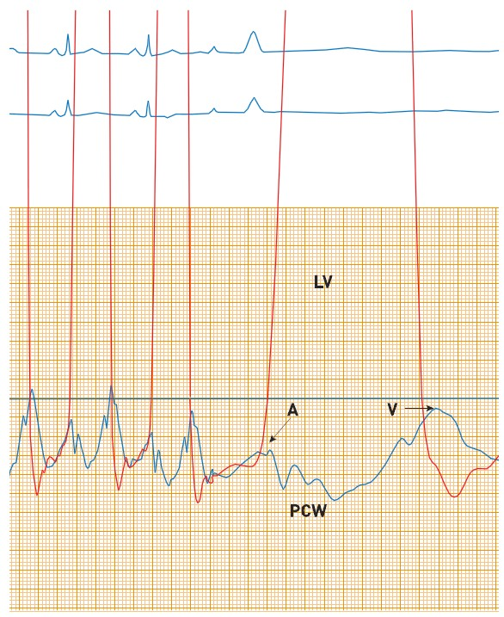

Right and left heart catheterisation (old)
Figure 6
Normal pulmonary capillary wedge pressure and LV pressureNote the time lag of the PCW “a” and “v” waves due to transit of pressure through the lungs and down to the transducer.
Morton J. Kern
©2025 Europa Group - All rights reserved.

