Slide 1


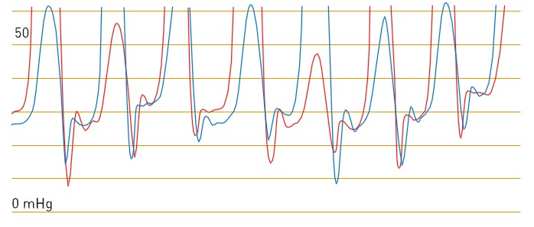

Right and left heart catheterisation (old)
Figure 7
Haemodynamics of diastolic dysfunctionwith early cessation of filling and impaired filling over the remainder of diastole producing a “Dip and plateau” or “square root sign” of the diastolic waveform.
Morton J. Kern
©2025 Europa Group - All rights reserved.

