Slide 1


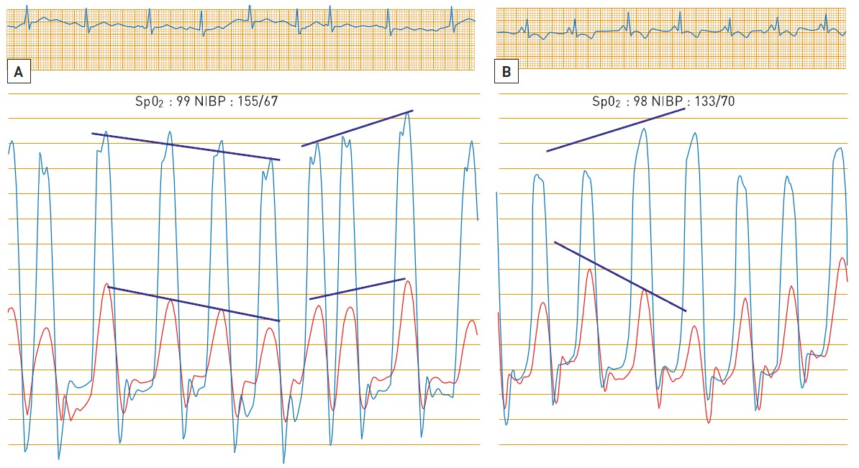

Right and left heart catheterisation (old)
Figure 8
Dynamic ventricular interactionThis produces different responses of LV and RV systolic pressures during inspiration. (A) shows concordant decrease and increase in LV/RV pressure during breathing. This pattern with the diastolic dysfunction of the dip/plateau is strongly associated with restrictive cardiomyopathy. (B) panel, discordant increase of LV with that of RV during respiration due to fixed cardiac volume with the RV filling at the expense of the LV decreasing, is the hall mark of constrictive physiology. SPO2: oxygen saturation. NIBP: Non-invasive blood pressure.
Morton J. Kern
©2025 Europa Group - All rights reserved.

