Slide 1


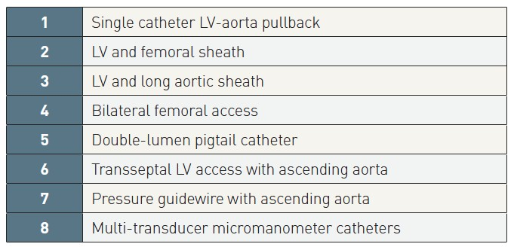

Right and left heart catheterisation (old)
Table 1
Catheter techniques to measure LV-aortic pressure gradients
Morton J. Kern
©2025 Europa Group - All rights reserved.

