Slide 1


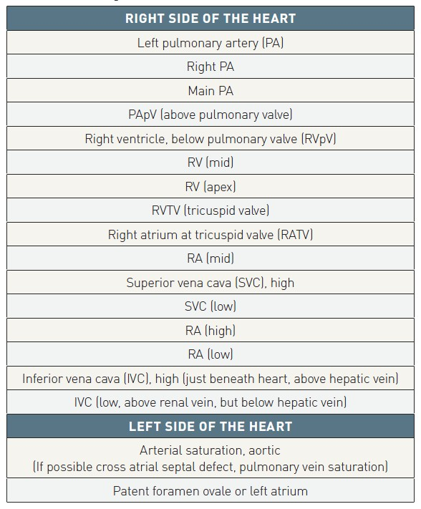

Right and left heart catheterisation (old)
Table 2
Sample sites for O2 saturations during a diagnostic saturation runAo: aortic; PA: pulmonary artery; RA: right atrium; RV: right ventricle From reference [2].
Morton J. Kern
©2025 Europa Group - All rights reserved.

